Slide 1
Go safe love to live

Slide 2
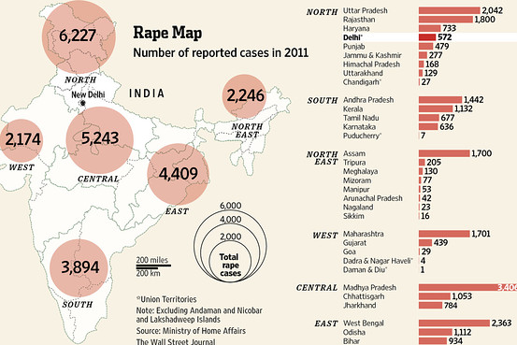
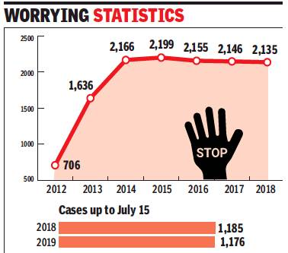
introduction
We are probably living in the worst time of our modern society.
We aim to make women feel as strong as ever
strong enough to fight the parasites of our society
strong enough to fight the odds
strong enough to protect themselves against any sexual assaults or any other crimes.
. Our idea is to design a system which shall make every place and every hour safer for women again.
The idea is to make up for the time it takes police to arrive at the location.

Slide 3
problems
There are certain pre-existing apps that do send a message to the saved contacts but none of them is effective and quick enough and according to a survey, the existing technology doesn’t make most women feel safe. A major change in the basic structure and a few add-ons to these is a necessity. In a lot of cases, it is observed that women do not file a complaint against the accused because of various reasons like not knowing the correct authority to report it to or feeling ashamed/guilty about the incident.

Slide 4
Prosposed Solution
An Android App consisting of many features to control the increasing crime rates.
First Feature we are providing is a Secured Hashed Algorithm Backed QR Code(SHATag) which will work by scanning the SHATag while someone is boarding the public vehicle, SHATag is secured mechanism to be provided by Govt. on verification of Drivers and Cabs, Buses and other public Vehicles. Scanning the QR Code, will enable the user to verify the service provider.
After Scanning Code, Realtime Location of the Vehicle will be shared with the Concerned family and authorities.
Secondly, we are providing some in built feature of app, that allows user on the way go create an emergency alarm, to the user’s relatives and authorities.
Another proposed solution is we can share audio input of the incident via app.

